Slide 1

CSE-4101 Artificial Intelligence
Search Strategy
Chapter-2

Slide 2
Today’s class
Search
Goal-based agents
Representing states and operators
Example problems
Generic state-space search algorithm
Specific algorithms
Breadth-first search
Depth-first search
Uniform cost search
Depth-first iterative deepening
Example problems revisited

Slide 3
Search Problem
The search problem is to find a sequence of actions which transforms the agent from the initial state to a goal state g∈G. A search problem is represented by a 4-tuple {S, s⁰, A, G}.
S: set of states
s⁰ ∈ S : initial state
A: S􀃆 S operators/ actions that transform one state to another state
G : goal, a set of states. G ⊆ S

Slide 4
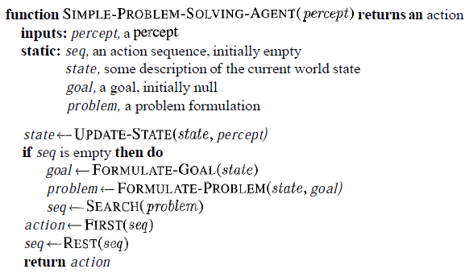
A simple problem-solving agent
It first formulates a goal and a problem,
Searches for a sequence of actions that would solve the problem, and executes actions
One at a time. When this is complete, it formulates another goal and starts over.
When it is executing the sequence it ignores its percepts: it assumes that the solution it has found will always work.

Slide 5
Problem formulation/Searching process
The generic searching process can be very simply described in terms of the following steps:
Do until a solution is found or the state space is exhausted.
1. Check the current state
2. Execute allowable actions to find the successor states.
3. Pick one of the new states.
4. Check if the new state is a solution state
If it is not, the new state becomes the current state and the process is repeated

Slide 6
Basic concepts
State: finite representation of the world that you want to explore at a given time
.
An initial state is the description of the starting configuration of the agent/The problem at the beginning.
Goal state: desired end state (can be several)/ test to determine if the goal has been reached.
An action or an Operator: a function that transforms a state into another (also called rule, transition, successor function, production, action).
Path Cost: The cost of a plan is referred to as the path cost
The path cost is a positive number, and a common path cost may be the sum of the costs of the steps in the path.
A problem can be defined formally by four components

Slide 7
Search Problem
The sequence of actions is called a solution plan.
Solution path is a path from the initial state to a goal state.
P = {a⁰, a¹, … , a^{N}} which leads to traversing a number of states {s⁰, s¹, … , s^{N+1}∈G}.
A sequence of states is called a path.
The cost of a path is a positive number.
In many cases the path cost is computed by taking the sum of the costs of each action.

Slide 8
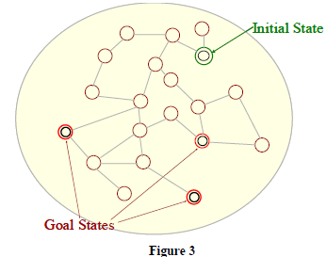
Illustration of a search process
We will now illustrate the searching process with the help of an example. Consider the problem depicted in Figure
Figure-1
s⁰ is the initial state.
The successor states are the adjacent states in the graph.
There are three goal states.

Slide 9
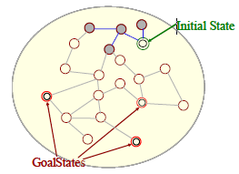
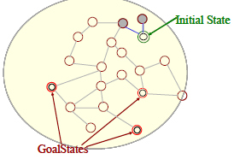
Figure-3
Figure-2
The two successor states of the initial state are generated.
The successors of these states are picked and their successors are generated.

Slide 10
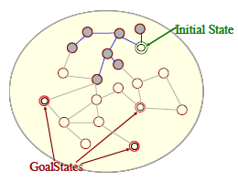
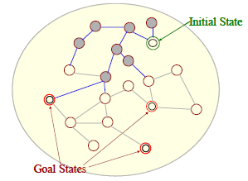
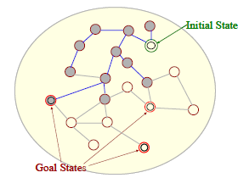
Figure-5
Figure-4
Successors of all these states are generated.
The successors are generated.
A goal state has been found.
Figure-6

Slide 11
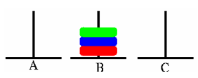
Example problem: Pegs and Disks problem
Consider the following problem. We have 3 pegs and 3 disks.
Operators: one may move the topmost disk on any needle to the topmost position to any other needle
In the goal state all the pegs are in the needle B as shown in the figure below..

Slide 12

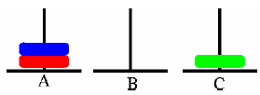
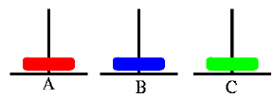
The initial state is illustrated below.
Now we will describe a sequence of actions that can be applied on the initial state.
Step 1: Move A → C
Step 2: Move A → B

Slide 13


Step 3: Move A → C
Step 4: Move B→ A
Step 5: Move C → B
Step 6: Move A → B

Slide 14
Step 7: Move C→ B

Slide 15
Another search problem :8 puzzle
In the 8-puzzle problem we have a 3×3 square board and 8 numbered tiles.
The board has one blank position.
Bocks can be slid to adjacent blank positions.
We can alternatively and equivalently look upon this as the movement of the blank position up, down, left or right.
The objective of this puzzle is to move the tiles starting from an initial position and arrive at a given goal configuration.

Slide 16
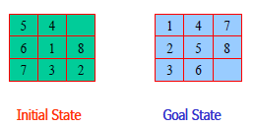
Problem Definition - Example, 8 puzzle
In the 8-puzzle problem we have a 3×3 square board and 8 numbered tiles
States: A state is a description of each of the eight tiles in each location that it can occupy.
Operators/Action: The blank moves left, right, up or down
Goal Test: The current state matches a certain state (e.g. one of the ones shown on previous slide)
Path Cost: Each move of the blank costs 1

Slide 17
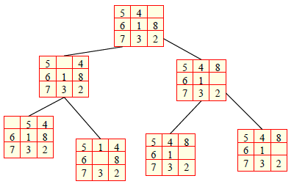
Problem Definition - Example, 8 puzzle
A small portion of the state space of 8-puzzle is shown below. Note that we do not need to generate all the states before the search begins. The states can be generated when required.

Slide 18
Uninformed Search/Blind Search Control Strategy
Also known as “blind search,” uninformed search strategies use no information about the likely “direction” of the goal node(s)
Do not have additional info about states beyond problem def.
Total search space is looked for solution
No info is used to determine preference of one child over other.
Example: 1. Breadth First Search(BFS), Depth First Search(DFS), Depth Limited Search (DLS)

Slide 19
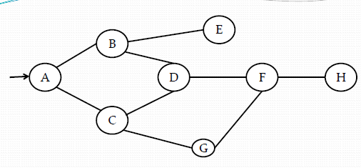
Uninformed Search/Blind Search Control Strategy
State Space without any extra information associated with each state

Slide 20
Breadth First Search (BFS)
Algorithm:
1. Create a variable QUEUE, put the starting node on
Queue and set it to initial state.
2.Loop: Until a Goal State is found or QUEUE is empty:
if nodes is empty then return failure
node := Remove-Front (QUEUE)
if Goal-Test[problem] applied to State(node) succeeds
then return node
new-nodes := Expand (QUEUE,Operators[problem]))
nodes := Insert-At-End-of-Queue(new-nodes)
end

Slide 21
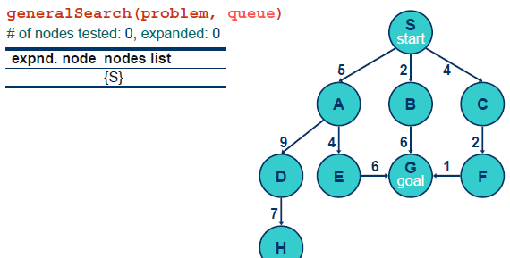
Breadth First Search

Slide 22
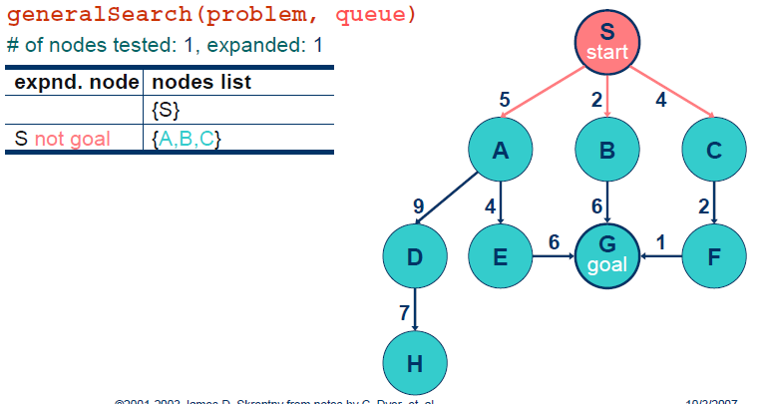

Slide 23
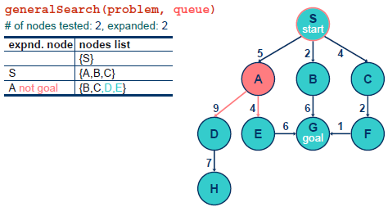

Slide 24
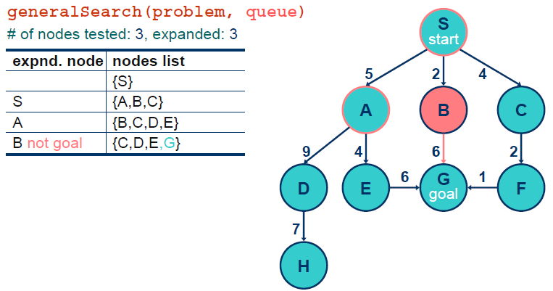

Slide 25
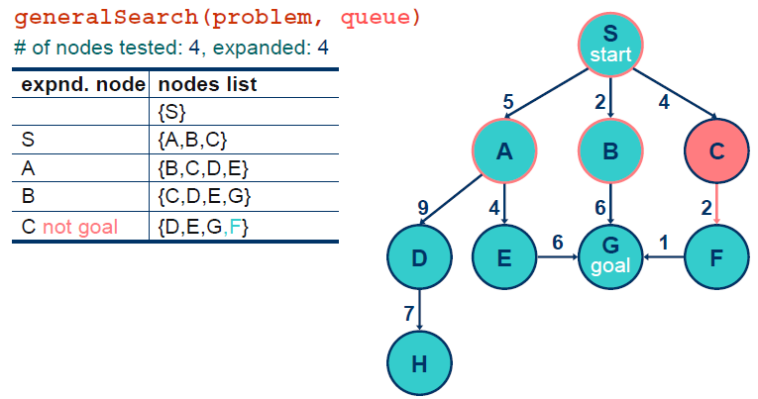

Slide 26
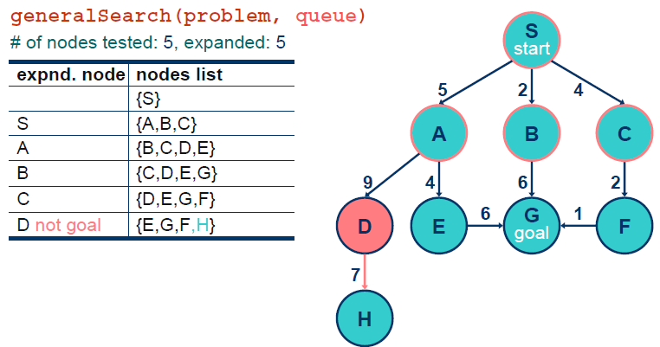

Slide 27
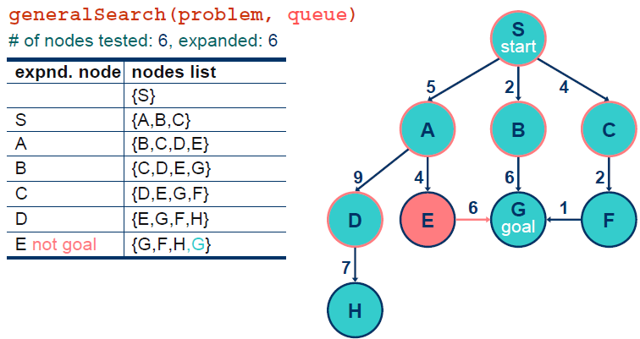

Slide 28
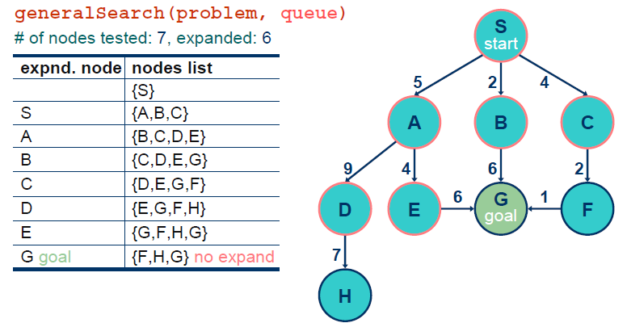

Slide 29
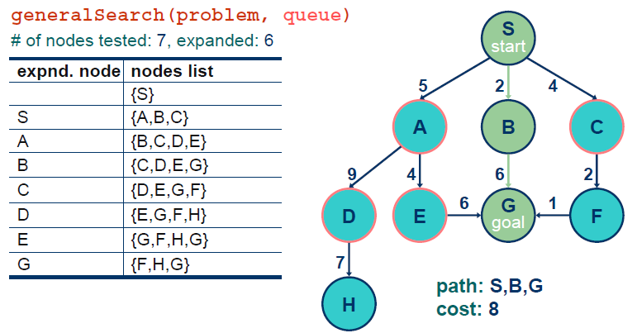

Slide 30
Another Breath-first search
S
A
D
B
D
A
E
C
E
E
B
B
F
11
D
F
B
F
C
E
A
C
G
14
17
15
15
13
G
C
G
F
19
19
17
G
25

Slide 31
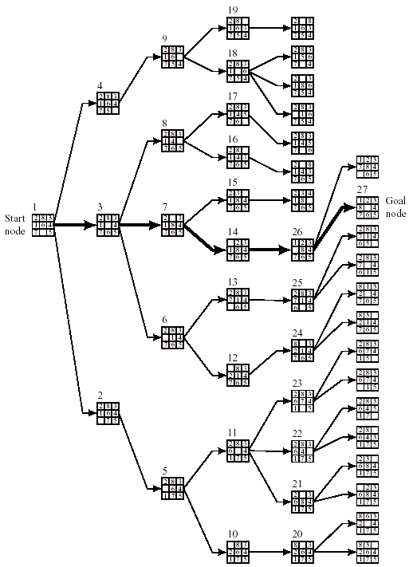
Figure 8.2 Breadth-First Search of the Eight-Puzzle

Slide 32
Advantages of BFS:
1. BFS is a systematic search strategy- all nodes at level n are considered before going to n+1 th level.
2. If any solution exists then BFS guarentees to find it.
3. If there are many solutions , BFS will always find the shortest path solution.
Disadvantages of BFS:
1. All nodes are to be generated at any level. So even unwanted nodes are to be remembered. Memory wastage.
2. Time and space complexity is exponential type- Hurdle.

Slide 33
Depth First Search (DFS)
Algorithm:
1. Create a variable STACK and set it to initial state.
2.Loop: Until a Goal State is found or STACK is empty:
if nodes is empty then return failure
node := Remove-Front (STACK)
if Goal-Test[problem] applied to State(STACK) succeeds
then return node
new-nodes := Expand (STACK,perators[problem]))
nodes := Insert-At-Front-of-Stack(new-nodes)
end

Slide 34
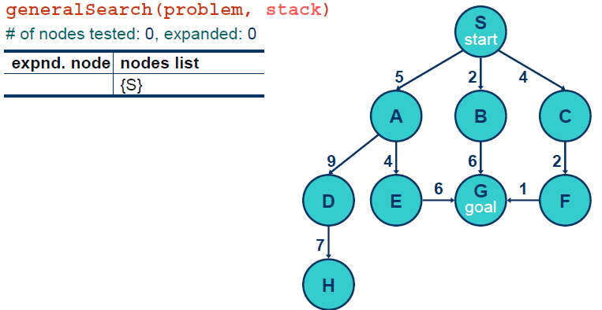
Depth-first

Slide 35
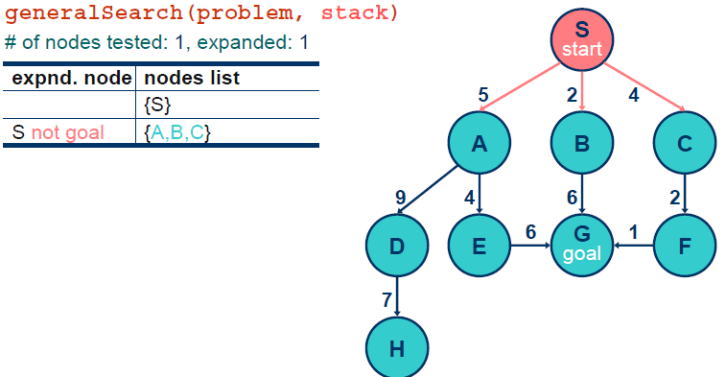

Slide 36
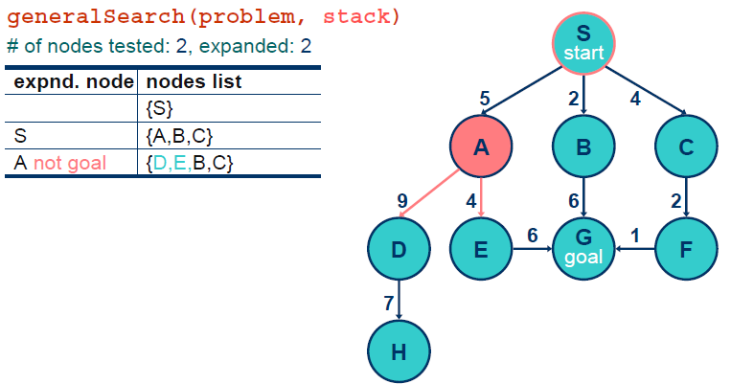

Slide 37
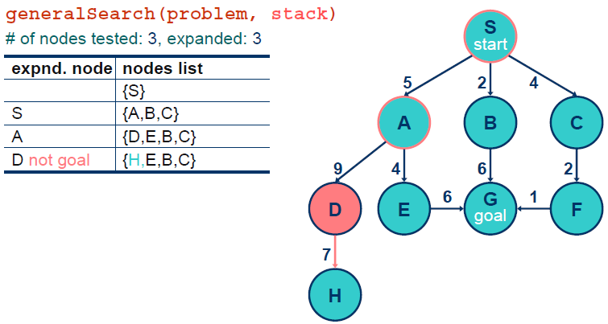

Slide 38
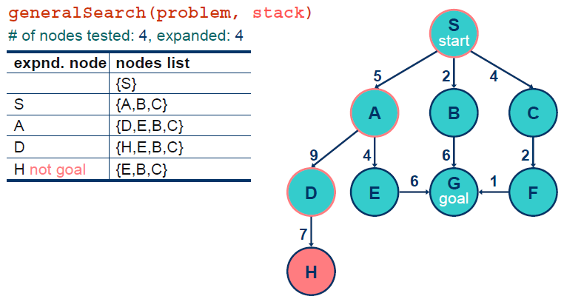

Slide 39
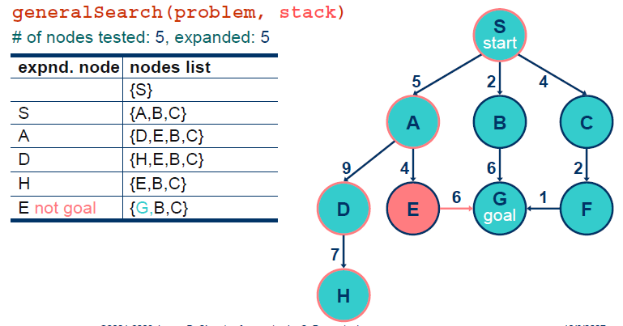

Slide 40
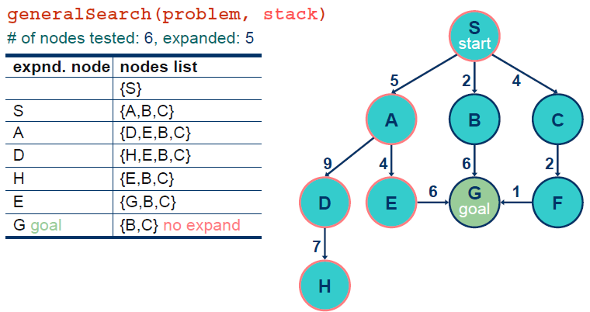

Slide 41
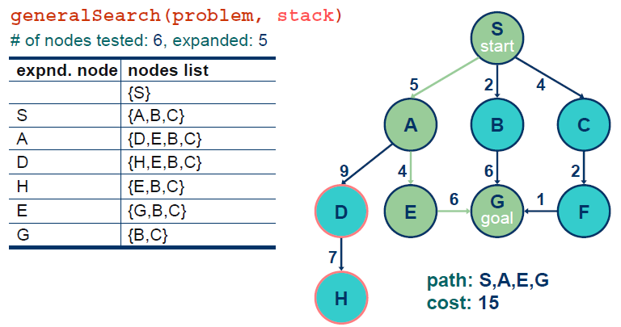

Slide 42
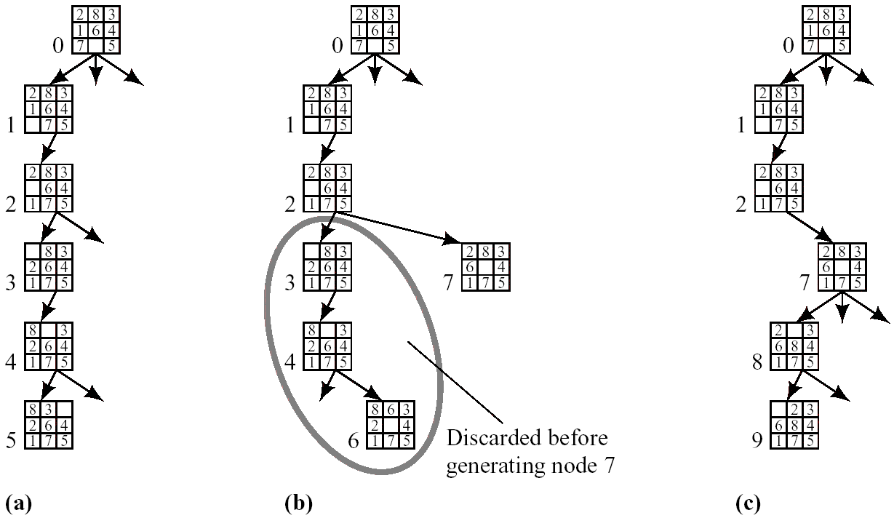
4. Depth-First or Backtracking Search (Cont’d)
8-puzzle example
Depth bound: 5
Operator order: left → up → right → down
Figure 8.3 Generation of the First Few Nodes in a Depth-First Search

Slide 43
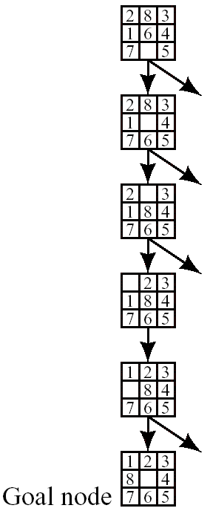
4. Depth-First or Backtracking Search (Cont’d)
The graph when the goal is reached in depth-first search

Slide 44
Advantages of DFS:
1. Memory requirements in DFS are less compared to BFS as only nodes on the current path are stored.
2. DFS may find a solution without examining much of the search space of all.
Disadvantages of BFS:
1. This search can go on deeper and deeper into the search
space and thus can get lost. This is referred to as blind
alley.!

Slide 45
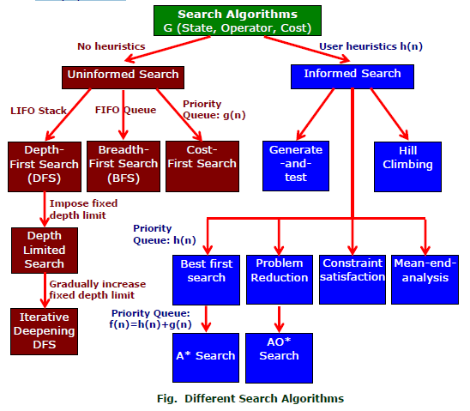

Slide 46
Informed Search
Also Called heuristic or intelligent search,
Uses information about the problem to guide the search,
Usually guesses the distance to a goal state and therefore efficient,
but the search may not be always possible.
The search so guided are called heuristic search and the methods used are called heuristics.

Slide 47
Advantage of Informed Search
A search strategy which searches the most promising branches of the state-space first can:
find a solution more quickly,
find solutions even when there is limited time available,
Often find a better solution, since more profitable parts of the state-space can be examined, while ignoring the unprofitable parts.
A search strategy which is better than another at identifying the most promising branches of a search-space is said to be more informed.

Slide 48
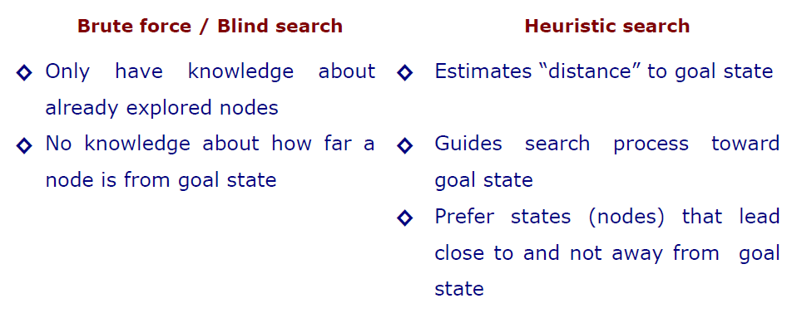
Heuristic Search Compared with other Search

Slide 49
Heuristics
Algorithm
First, generate a possible solution which can either be a point in the problem space Or a path from the initial state.
Then, test to sea if this possible solution is a real solution by comparing the state
Reached with the set of goal states.
If it is real solution, return, else repeat from the first again.

Slide 50
Heuristics Search Technique
Example of Heuristic Function
A heuristic function at a node n is an estimate of the optimum cost from the current node to a goal. It is denoted by h(n).
h(n) = estimated cost of the cheapest path from node n to a goal node
Example 1: We want a path from Kolkata to Guwahati
Heuristic for Guwahati may be straight-line distance between Kolkata and Guwahati
h(Kolkata) = euclideanDistance(Kolkata, Guwahati)

Slide 51
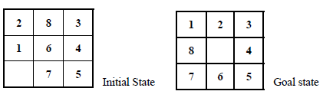
Example 2: 8-puzzle: Misplaced Tiles Heuristics is the number of tiles out of place.
The first picture shows the current state n, and the second picture the goal state.h(n) = 5 because the tiles 2, 8, 1, 6 and 7 are out of place.
Manhattan Distance Heuristic: Another heuristic for 8-puzzle is the Manhattan distance heuristic. This heuristic sums the distance that the tiles are out of place. The distance of a tile is measured by the sum of the differences in the x-positions and the y-positions.
For the above example, using the Manhattan distance heuristic,
h(n) = 1 + 1 + 0 + 0 + 0 + 1 + 1 + 2 = 6

Slide 52
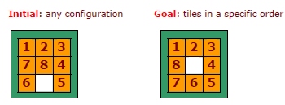
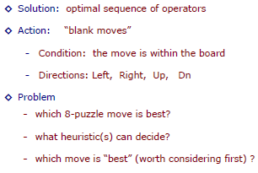

Slide 53
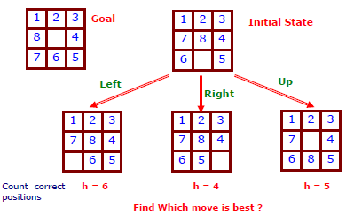
Action
Three possible moves –left,up,right

Slide 54
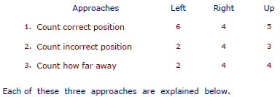
Apply Heuristic
Three different Approaches
-count correct position of each tile, compare to goal state.
-count incorrect position of each tile, compare to goal state.
-count how far away each tile is from it is correct position.

Slide 55
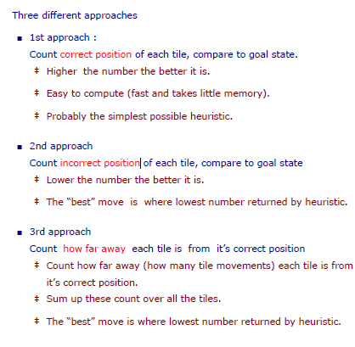

Slide 56
Best First Search
Idea: use an evaluation function f(n) for each node
f(n) provides an estimate for the total cost.
Expand the node n with smallest f(n).
Implementation:
Order the nodes in fringe increasing order of cost.
The algorithm maintains a priority queue of nodes to be explored.
A cost function f(n) is applied to each node.
The nodes are put in OPEN in the order of their f values.
Nodes with smaller f(n) values are expanded earlier. The generic best first search algorithm is outlined below.

Slide 57
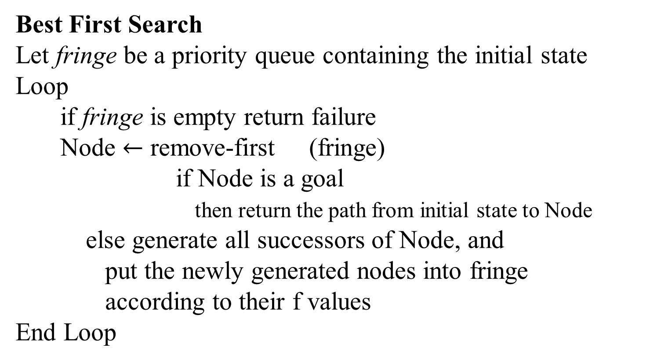
Algorithm:
Best First Search
Let fringe be a priority queue containing the initial state
Loop
if fringe is empty return failure
Node $←$ remove-first (fringe)
if Node is a goal
then return the path from initial state to Node
else generate all successors of Node, and
put the newly generated nodes into fringe
according to their f values
End Loop

Slide 58
Greedy Best First Search
In greedy search, the idea is to expand the node with the smallest estimated cost to reach the goal.
We use a heuristic function f(n) = h(n)
h(n) estimates the distance remaining to a goal.
e.g., h_{SLD}(n) = straight-line distance from n to Bucharest Greedy best-first search expands the node that appears to be closest to goal

Slide 59
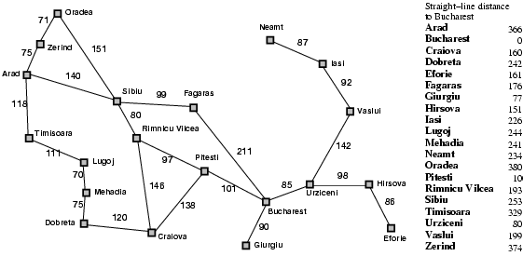
Romania with step costs in km

Slide 60

Greedy best-first search example

Slide 61
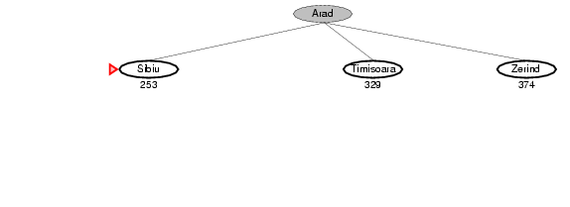
Greedy best-first search example

Slide 62
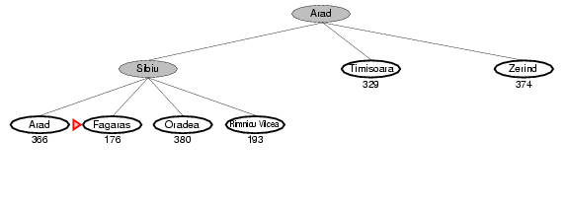
Greedy best-first search example

Slide 63
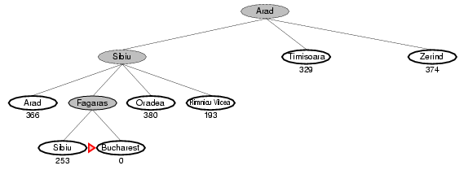
Greedy best-first search example

Slide 64
Properties of greedy best-first search
Complete? No – can get stuck in loops, e.g., Iasi → Neamt → Iasi → Neamt →
Time? O(b^{m}), but a good heuristic can give dramatic improvement
Space? O(b^{m}) -- keeps all nodes in memory
Optimal? No

Slide 65
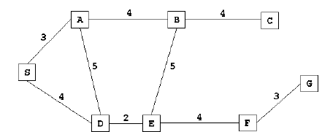
Figure 2 is an example of a route finding problem. S is the starting state, G is the goal state.
Figure 2
Let us run the greedy search algorithm for the graph given in Figure 2. The straight line distance heuristic estimates for the nodes are shown in Figure

Slide 66
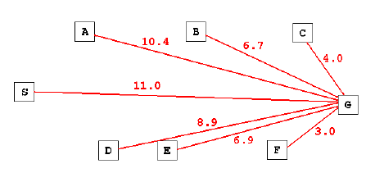
Figure 3

Slide 67

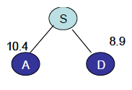
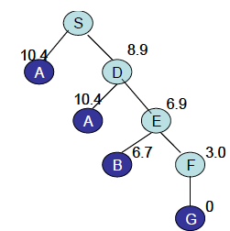


Step 1: S is expanded. Its children are A and D.
Step 2: D has smaller cost and is expanded next.

Slide 68
A* Search
Idea: avoid expanding paths that are already expensive
A* is a best first search algorithm with
f(n)=g(n)+h(n).
Where
g(n)=sum of edge costs from start to n (distance current node from start)
h(n)=estimate of lowest cost path from goal to current node.
f(n)=actual distance so far estimated distance remaining.
Best First search has f(n)=h(n)
We can prove that if h(n) is admissible, then the search will find and optimal solution

Slide 69
The A* Algorithm
Keep a list of active states. Start by putting the initial state into this list, then repeat the following:
Pick the active state with the lowest f^ value, call it state S
If S is the goal state, then we’ve found the best path. Exit!
Remove S from the list
Generate all the successors of this state. If the path from the initial state through S to any of these states is better than one we’re found before, then update the successor state to remember that the best path to it was from S. Add those successor states that we have not processed before to the active list.

Slide 70
Comments on the A* Algorithm
If a path to the goal exists, then A* will always find the shortest path to the goal
Because A* closely resembles a breadth-first type of search, it consumes lots of memory

Slide 71
Algorithm A* (Implantation Technique)
A* that maintains the search graph
Create a search graph, G, consisting solely of the start node, n₀ → put n₀ on a list OPEN
Create a list CLOSED: initially empty
If OPEN is empty, exit with failure
Select the first node on OPEN → remove it from OPEN → put it on CLOSED: node n
If n is a goal node, exit successfully: obtain solution by tracing a path along the pointers from n to n₀ in G
Expand node n, generating the set, M, of its successors that are not already ancestors of n in G →install these members of M as successors of n in G

Slide 72
Algorithm A* (Implantation Technique)
Establish a pointer to n from each of those members of M that were not already in G → add these members of M to OPEN
→ for each member, m, redirect its pointer to n if the best path to m found so far is through n → for each member of M already on CLOSED, redirect the pointers of each of its descendants in G
Reorder the list OPEN in order of increasing values
Go to step 3
Redirecting pointers of descendants of nodes
Save subsequent search effort

Slide 73

A* search example

Slide 74

A* search example

Slide 75

A* search example

Slide 76

A* search example

Slide 77

A* search example

Slide 78

A* search example

Slide 79
A* search: properties
The algorithm A* is admissible. This means that provided a solution sexists, the first solution found by A* is an optimal solution. A* is admissibility under the following conditions:
In the state space graph
Every node has a finite number of successors
Every arc in the graph has a cost greater then some e>0
Heuristic function: for every node n, h(n) ≤ h*(n)
A* is also complete under the above conditions.

Slide 80
9.2.2 Admissibility of A*
Conditions that guarantee A* always finds minimal cost paths
Each node in the graph has a finite number of successors
All arcs in the graph have costs greater than some positive amount ε

Slide 81
Admissible heuristics
h(n) is said to be a admissible if it underestimate the cost of any solution that reached from n. if C*(n) is the cost of the cheapest solution path from n to a goal node and if h is admissible. h(n)<=C*(n).
A heuristic h(n) is admissible if for every node n,
h(n) ≤ h*(n), where h*(n) is the true cost to reach the goal state from n.
An admissible heuristic never overestimates the cost to reach the goal, i.e., it is optimistic
Example: h_{SLD}(n) (never overestimates the actual road distance)
Theorem: If h(n) is admissible, A* using TREE-SEARCH is optimal

Slide 82

Optimality of A* (proof)
Suppose some suboptimal goal G₂ has been generated and is in the fringe. Let n be an unexpanded node in the fringe such that n is on a shortest path to an optimal goal G.
f(G₂) = g(G₂) since h(G₂) = 0
f(G) = g(G) since h(G) = 0
g(G₂) > g(G) since G₂ is suboptimal
f(G₂) > f(G) from above
We want to prove:
f(n) < f(G2)
(then A* will prefer n over G2)

Slide 83
Optimality of A* (proof)
Suppose some suboptimal goal G₂ has been generated and is in the fringe. Let n be an unexpanded node in the fringe such that n is on a shortest path to an optimal goal G.
f(G₂) > f(G) copied from last slide
h(n) ≤ h*(n) since h is admissible (under-estimate)
g(n) + h(n) ≤ g(n) + h*(n) from above
f(n) ≤ f(G) since g(n)+h(n)=f(n) & g(n)+h*(n)=f(G)
f(n) < f(G2) from top line.
Hence: n is preferred over G2

Slide 84

Optimality of A*
A* expands nodes in order of increasing f value
Gradually adds "f-contours" of nodes
Contour i has all nodes with f=f_{i}, where f_{i} < f_{i+1}

Slide 85
Properties of Heuristics
Dominance:
h2 is said to dominate h1 if h2(n) ≥ h1(n) for any node n.
A* will expand fewer nodes on average using h2 than h1.
Proof:
Every node for which f(n) < C* will be expanded. Thus n is expanded whenever
h(n) < f* - g(n)
Since h2(n) ≥ h1(n) any node expanded using h2 will be expanded using h1.

Slide 86
Using multiple heuristics
Suppose you have identified a number of non-overestimating heuristics for a problem: h1(n), h2(n), … , hk(n)
Then max (h1(n), h2(n), … , hk(n))
is a more powerful non-overestimating heuristic. This follows from the property of dominance

Slide 87
An alternative: IDA*
IDA* = Iterative Deepening A*
Performs a series of depth-first searches, each with a certain cost cut-off. When the f value for a node exceeds this cut-off, then the search must backtrack. If the goal node was not found during the search, then more depth-first searches are conducted with higher cut-offs until the goal is found.

Slide 88

IDA* Algorithm
Iterative deepening A* or IDA* is similar to iterative-deepening depth-first, but with the following modifications:
The depth bound modified to be an f-limit
1. Start with limit = h(start)
2. Prune any node if f(node) > f-limit
3. Next f-limit=minimum cost of any node pruned
The cut-off for nodes expanded in an iteration is decided by the f-value of the nodes.

Slide 89


IDA* Algorithm
Consider the graph in Figure 3. In the first iteration, only node a is expanded. When a is expanded b and e are generated. The f value of both are found to be 15.
For the next iteration, a f-limit of 15 is selected, and in this iteration, a, b and c are expanded. This is illustrated in Figure 3

Slide 90
Why do we use IDA*?
In the case of A*, it I usually the case that for slightly larger problems, the algorithm runs out of main memory much earlier than the algorithm runs out of time. IDA* can be used in such cases as the space requirement is linear. In fact 15-puzzle problems can be easily solved by IDA*, and may run out of space on A*.
IDA* is not thus suitable for TSP type of problems. Also IDA* generates duplicate nodes in cyclic graphs. Depth first search strategies are not very suitable for graphs containing too many cycles.

Slide 91

Why do we use IDA*?
IDA* is complete, optimal, and optimally efficient (assuming a consistent, admissible heuristic), and requires only a polynomial amount of storage in the worst case:
IDA* uses very little memory

Slide 92
SMA*
Simplified Memory Bounded A* is a shortest path algorithm based on the A* algorithm.
The main advantage of SMA* is that it uses a bounded memory, while the A* algorithm might need exponential memory.
All other characteristics of SMA* are inherited from A*.

Slide 93
SMA*
SMA* are restricted memory best first search algorithms that utilize all the memory available.
The algorithm executes best first search while memory is available.
When the memory is full the worst node is dropped but the value of the forgotten node is backed up at the parent.

Slide 94
SMA* Process
ke A*, it expands the most promising branches according to the heuristic. What sets SMA* apart is that it prunes nodes whose expansion has revealed less promising than expected. The approach allows the algorithm to explore branches and backtrack to explore other branches.
Expansion and pruning of nodes is driven by keeping two values of f {\displaystyle f} for every node. Node x {\displaystyle x} stores a value f ( x ) {\displaystyle f(x)} which estimates the cost of reaching the goal by taking a path through that node. The lower the value, the higher the priority. As in A* this value is initialized to h ( x ) + g ( x ) {\displaystyle h(x)+g(x)} , but will then be updated to reflect changes to this estimate when its children are expanded. A fully expanded node will have an f {\displaystyle f} value at least as high as that of its successors. In addition, the node stores the f {\displaystyle f} value of the best forgotten successor. This value is restored if the forgotten successor is revealed to be the most promising successor.
Starting with the first node, it maintains OPEN, ordered lexicographically by f {\displaystyle f} and depth. When choosing a node to expand, it chooses the best according to that order. When selecting a node to prune, it chooses the worst.

Slide 95
SMA* Properties
Maintain f-costs of the best path (lower bound)
The best lower bound node is always expanded
Guaranteed to return an optimal solution
MAX must be big enough to hold the shortest path
Behaves identical to A* if MAX > number of nodes generated

Slide 96
Local Search
Local search methods work on complete state formulations. They keep only a small number of nodes in memory.
Local search is useful for solving optimization problems:
o Often it is easy to find a solution
o But hard to find the best solution
Algorithm goal:
find optimal configuration (e.g., TSP),
Hill climbing
Gradient descent
Simulated annealing
• For some problems the state description contains all of the information relevant for a solution. Path to the solution is unimportant.
• Examples:
o map coloring
o 8-queen

Slide 97
Hill Climbing Algorithm
Very simple idea: Start from some state s,
Move to a neighbor t with better score. Repeat.
Question: what’s a neighbor?
You have to define that!
The neighborhood of a state is the set of neighbors
Also called ‘move set’
Similar to successor function

Slide 98

Neighbors: TSP
state: A-B-C-D-E-F-G-H-A
f = length of tour

Slide 99
Hill Climbing Algorithm
Question: What’s a neighbor?
(vaguely) Problems tend to have structures. A small change produces a neighboring state.
The neighborhood must be small enough for efficiency
Designing the neighborhood is critical. This is the real ingenuity – not the decision to use hill climbing.
Question: Pick which neighbor?
Question: What if no neighbor is better than the current state?

Slide 100

Hill Climbing Algorithm
1.Pick initial state s
2.Pick t in neighbors(s) with the largest f(t)
3.IF$f\left(t\right)≤ f(s)$THEN stop, return s
4. s = t. GOTO 2.
Not the most sophisticated algorithm in the world.
Very greedy.
Easily stuck.
your enemy:
local optima

Slide 101

Local optima in hill climbing
The rest of the lecture is about
Escaping
local optima

Slide 102
Variation of Hill Climbing
Question: How do we make hill climbing less greedy?
▪Stochastic hill climbing
•Randomly select among better neighbors
•The better, the more likely
•Pros / cons compared with basic hill climbing?
•Question: What if the neighborhood is too large to enumerate? (e.g. N-queen if we need to pick both the column and the move within it)
▪First-choice hill climbing
•Randomly generate neighbors, one at a time
•If better, take the move
•Pros / cons compared with basic hill climbing?

Slide 103

Hill Climbing Algorithm

Slide 104

Hill Climbing Algorithm
Maximization function is called Objective Function
 Minimization function is called Heuristic Cost function
 Heuristic cost= distance, time, money spent
 Objective function= profit, success

Slide 105
Hill Climbing Algorithm
Evaluate the initial state. If it is the goal state then return and quit. Otherwise continue with initial state as current state.
Loop until a solution is found or until there are no new operators left to be applied to the current state:
a. Select operator that has not been applied to the current state and apply it to
produce the new state.
b. Evaluate the new state
i. If it is the goal state, then return and quit
ii. If it is not a goal state but it is better than the current state then
make it the current state.
iii. If it is not better than the current state then continue in the loop.

Slide 106
Hill Climbing Algorithm Problems
Local maxima
Once the top of a hill is reached the algorithm will halt since every possible step leads down.
Plateaux
If the landscape is flat, meaning many states have the same goodness, algorithm degenerates to a random walk.
Ridges
If the landscape contains ridges, local improvements may follow a zigzag path up the ridge, slowing down the search.

Slide 107
Advantages of Hill Climbing
It can be used in continuous as well as discrete domains.
Disadvantages of Hill Climbing
1. Not efficient method –not suitable to problems where the value of
heuristic function drops off suddenly when solution may be in sight.
2.Local search method- gets caught up in local maxima/minima.
Solution to Local Maxima problem:
1. Backtracking to some earlier node and try different direction.
2. Simulated annealing

Slide 108
SIMULATED ANNEALING
Anneal
To subject (glass or metal) to a process of heating and slow cooling in order to toughen and reduce brittleness.
1.Pick initial state s
2.Randomly pick t in neighbors(s)
3.IF f(t) better THEN accept s t.
4.ELSE /* t is worse than s */
5. accept s t with a small probability
6.GOTO 2 until bored.

Slide 109

SIMULATED ANNEALING
How to choose the small probability?
idea 1: p = 0.1
idea 2: p decreases with time
idea 3: p decreases with time, also as the ‘badness’ |f(s)-f(t)| increases
If f(t) better than f(s), always accept t
Otherwise, accept t with probability

Slide 110
SIMULATED ANNEALING
If f(t) better than f(s), always accept t
Otherwise, accept t with probability
Temp is a temperature parameter that ‘cools’ (anneals) over time, e.g. Temp Temp*0.9 which gives Temp=(T0)#iteration
High temperature: almost always accept any t
Low temperature: first-choice hill climbing
If the ‘badness’ (formally known as energy difference) |f(s)-f(t)| is large, the probability is small.

Slide 111
SA Algorithm
assuming we want to maximize f()
current = Initial-State(problem)
for t = 1 to œ do
T = Schedule(t) ; // T is the current temperature, which is monotonically decreasing with t
if T=0 then return current ; //halt when temperature = 0
next = Select-Random-Successor-State(current) deltaE = f(next) - f(current) ; // If positive, next is better than current. Otherwise, next is worse than current.
if deltaE > 0 then current = next ; // always move to a better state
else current = next with probability p = exp(deltaE / T) ; // as T 0,
p 0; as deltaE → -, p →0
end

Slide 112
SA Algorithm Design Issues
Cooling scheme important
Neighborhood design is the real ingenuity, not the decision to use simulated annealing.
Not much to say theoretically
▪With infinitely slow cooling rate, finds global optimum with probability 1.
Proposed by Metropolis in 1953 based on the analogy that alloys manage to find a near global minimum energy state, when annealed slowly.
Easy to implement.
Try hill-climbing with random restarts first!

Slide 113

Genetic algorithm
Genetic algorithm: a special way to generate neighbors, using the analogy of cross-over, situutation, and natural selection.

Slide 114
Genetic Algorithms
In the early 1970s, John Holland introduced the
concept of genetic algorithms.
His aim was to make computers do what nature
does. Holland was concerned with algorithms
that manipulate strings of binary digits.
Each artificial “chromosomes” consists of a
number of “genes”, and each gene is represented
by 0 or 1:

Slide 115
Genetic Algorithms
Nature has an ability to adapt and learn without
being told what to do. In other words, nature
finds good chromosomes blindly. GAs do the
same. Two mechanisms link a GA to the problem
it is solving: encoding and evaluation.
The GA uses a measure of fitness of individual
chromosomes to carry out reproduction. As
reproduction takes place, the crossover operator
exchanges parts of two single chromosomes, and
the mutation operator changes the gene value in
some randomly chosen location of the chromosome.

Slide 116
Basic Genetic Algorithms
Step 1: Represent the problem variable domain as
a chromosome of a fixed length, choose the size
of a chromosome population N, the crossover
probability pc and the mutation probability pm.
Step 2: Define a fitness function to measure the
performance, or fitness, of an individual
chromosome in the problem domain. The fitness
function establishes the basis for selecting
chromosomes that will be mated during
reproduction.

Slide 117
Basic Genetic Algorithms
Step 3: Randomly generate an initial population of
chromosomes of size N:
x1, x2, . . . , xN
Step 4: Calculate the fitness of each individual
chromosome:
f (x1), f (x2), . . . , f (xN)
Step 5: Select a pair of chromosomes for mating
from the current population. Parent
chromosomes are selected with a probability
related to their fitness.

Slide 118
Basic Genetic Algorithms
Step 6: Create a pair of offspring chromosomes by
applying the genetic operators − crossover and
mutation.
Step 7: Place the created offspring chromosomes
in the new population.
Step 8: Repeat Step 5 until the size of the new
chromosome population becomes equal to the
size of the initial population, N.
Step 9: Replace the initial (parent) chromosome
population with the new (offspring) population.
Step 10: Go to Step 4, and repeat the process until
the termination criterion is satisfied.

Slide 119
Genetic Algorithms
GA represents an iterative process. Each iteration is
called a generation. A typical number of generations
for a simple GA can range from 50 to over 500. The
entire set of generations is called a run.
Because GAs use a stochastic search method, the
fitness of a population may remain stable for a
number of generations before a superior chromosome
appears.
A common practice is to terminate a GA after a
specified number of generations and then examine
the best chromosomes in the population. If no
satisfactory solution is found, the GA is restarted.

Slide 120

Genetic algorithms: case study
A simple example will help us to understand how
a GA works. Let us find the maximum value of
the function (15x − x2) where parameter x varies
between 0 and 15. For simplicity, we may
assume that x takes only integer values. Thus,
chromosomes can be built with only four genes:

Slide 121
Genetic algorithms: case study
Suppose that the size of the chromosome population
N is 6, the crossover probability pc equals 0.7, and
the mutation probability pm equals 0.001. The
fitness function in our example is defined by
f(x) = 15 x − x2

Slide 122

The fitness function and chromosome locations

Slide 123
In natural selection, only the fittest species can
survive, breed, and thereby pass their genes on to
the next generation. GAs use a similar approach,
but unlike nature, the size of the chromosome
population remains unchanged from one
generation to the next.
The last column in Table shows the ratio of the
individual chromosome’s fitness to the
population’s total fitness. This ratio determines
the chromosome’s chance of being selected for
mating. The chromosome’s average fitness
improves from one generation to the next.

Slide 124

Roulette wheel selection
The most commonly used chromosome selection techniques is the roulette wheel selection.

Slide 125
Crossover operator
In our example, we have an initial population of 6
chromosomes. Thus, to establish the same
population in the next generation, the roulette
wheel would be spun six times.
Once a pair of parent chromosomes is selected,
the crossover operator is applied.
First, the crossover operator randomly chooses a
crossover point where two parent chromosomes
“break”, and then exchanges the chromosome
parts after that point. As a result, two new
offspring are created.
If a pair of chromosomes does not cross over,
then the chromosome cloning takes place, and the
offspring are created as exact copies of each
parent.

Slide 126

Crossover operator

Slide 127
Mutation operator
Mutation represents a change in the gene.
Mutation is a background operator. Its role is to
provide a guarantee that the search algorithm is
not trapped on a local optimum.
The mutation operator flips a randomly selected
gene in a chromosome.
The mutation probability is quite small in nature,
and is kept low for GAs, typically in the range
between 0.001 and 0.01.

Slide 128

Mutation operator

Slide 129

The genetic algorithm cycle

Slide 130
Steps in the GA development
1. Specify the problem, define constraints and
optimum criteria;
2. Represent the problem domain as a
chromosome;
3. Define a fitness function to evaluate the
chromosome performance;
4. Construct the genetic operators;
5. Run the GA and tune its parameters.

Slide 131

Genetic algorithm
1.Let s1, …, sN be the current population
2.Let pi = f(si) /$∑j$f(sj) j f(sj) be the reproduction probability
3.FOR k = 1; k<N; k+=2
parent1 = randomly pick according to p
parent2 = randomly pick another
randomly select a crossover point, swap strings of parents 1, 2 to generate children t[k], t[k+1]
4.FOR k = 1; k<=N; k++
•Randomly mutate each position in t[k] with a small probability (mutation rate)
5.The new generation replaces the old: { s } $←${ t }. Repeat.

Slide 132


Proportional selection

Slide 133
Variations of genetic algorithm
Parents may survive into the next generation
Use ranking instead of f(s) in computing the reproduction probabilities.
Cross over random bits instead of chunks.
Optimize over sentences from a programming language.

Slide 134
Confession
It is possible that some sentences or some information were included in these slides without mentioning exact references. I am sorry for violating rules of intellectual property. When I will have a bit more time, I will try my best to avoid such things.
These slides are only for students in order to give them very basic concepts about the giant, “Networking”, not for experts.
Since I am not a network expert, these slides could have wrong/inconsistent information…I am sorry for that.
Students are requested to check references and Books, or to talk to Network engineers.

